Slide 1

Professor David Flynn
Loops and Control - EN2083

Slide 2

Loops and Control
(everything you need to do real work)
(again, thanks to Dr Scott Roy)
Example of wind up music box
#Pseudocode
k=minimum energy required for music box to work
While strength of coil > k #Provided there are several turns of the coil the music will play
Play music
Else: Music stops #Once the coil has no energy the music stops
The is similar to a loop but in mechanical form where the music repeats over again for the number of winds.

Slide 3
Statements
(just to formalise what we know, and introduce ‘scope’)

Slide 4
Statements
A statement is a unit of command
A program contains one or more statements, each terminated by an end of line (or ‘;’)
    assignment statements
    decision/selection statements
    repetition/loop statements
    function calls
functions / classes also define their interface

Slide 5
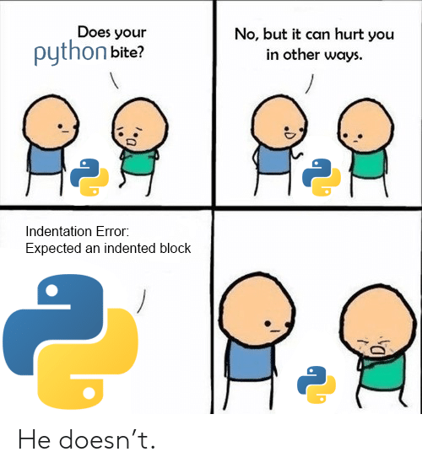
Compound Statements
In Python a compound statement is a group of statements collected in a single unit by their level of indentation.
A single statement
    while student<=10 : # when student counter <=10
    result = input(“Enter(1=pass,2=fail):”)
    result=int(result) # input next exam result
    if result==1 : # if student passes
    passes+=1 # add one to passes
    else: # else
    failures+=1 # add one to failures
    student+=1 # add one to counter
A good thing about Python is it will often recognise and tell you via the command window when you have an indentation error
A compound statement
*Any line of code you write is a statement

Slide 6
Functions & variable scope
'Usually, the local scope references the local names of the current function. Outside functions, the scope references the... module’s namespace. '
  # First setup variables
  C=3.0 × 10⁸ #speed of light
  V_sound = 340 #speed of sound
  ϵr= 8.854 x 10-12 #Permittivity of free space
  n_air= 1.0 #Refractive index air
Black box as the variables don’t change
i.e. function variables are in a 'black box' - and can't be seen outside. A good thing
actually scope is a bit more subtle than that, but let's not go into that here.

Slide 7
Class Question…
Function Variables are typically values that don’t change. Such as permittivity of free space, speed of sound, speed of light…
These are usually the first thing that is defined within your code and are called within your equations later in your code.
Calculate the speed of light in zircon, a material used in jewellery to imitate diamond.
The equation for the index of refraction is n=c/v
Function variable
n_zircon= 1.923
  # First setup variables
  n_Zircon= 1.923 #Refractive index Zircon
  C=3.0 × 10⁸ #speed of light
  #equation for refractive index n=c/v
  #rearrange equation
  v=C/n_zircon
  print(‘v’)
Clue : Think to variables lecture
Next click reveals answer…
Answer: spelling of variables for n_zircon versus n_Zircon
Terminal Window
Error
What is wrong with the code here?
This will help in debugging
code to fix errors

Slide 8
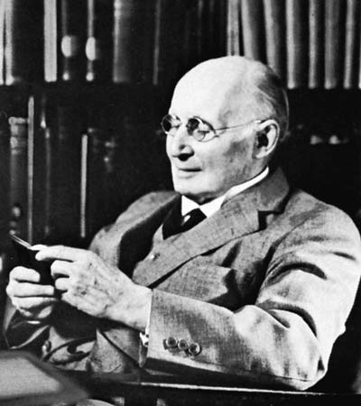
Decision making
  “Operations of thought are like cavalry charges in a battle—they are strictly limited in number, they require fresh horses, and must only be made at
  decisive moments”
  Alfred North Whitehead 1861-1947

Slide 9
if statements
consider again the example of finding quadratic equation roots.
    discrim = pow(coeff_2,2) - 4*coeff_1*coeff_3
    denom = 2*coeff_1
    root_1 = (-b + sqrt(discrim))/denom
real roots only exist if the discriminant is positive.
in an algorithm we should be able to make logical decisions based on our calculations.
Mastering if statements will make life easier throughout your programming career as they are used everywhere
Notes:
Idea of functions hiding previous work to simplify code should be introduced here.

Slide 10
if statements
would like to do this, for people who haven't learned about complex numbers :
    discrim = pow(coeff_2,2) - 4*coeff_1*coeff_3
    denom = 2*coeff_1
    if (discrim < 0):
        print(“no real roots”)
        break # terminates program
    else:
        root_1 = (-b + sqrt(discrim))/denom
        root_2 = (-b - sqrt(discrim))/denom
and indeed we can ☺
Notes:
Idea of functions hiding previous work to simplify code should be introduced here.

Slide 11

if statements
Selection statements take three forms:
single selection
    if (att < 75):
    grade = “CR”
double selection
    if (marks < 40):
    passed = 0
    else:
    passed = 1
indentation tells how much is if or else
note ':', no ‘then’
note ':'
Notes:
Idea of functions hiding previous work to simplify code should be introduced here.

Slide 12
if statements
with multiple statements, the third type, the formatting is done like this:
    if (<expression1>):
        # statements indented by 4 spaces
        # when <expression1> true
    elif (<expression2>):
        # statements indented by 4 spaces
        # when <exp2> true but <exp1> false
    else:
        # statements indented by 4 spaces
        # when both expressions false
Notes:
Idea of functions hiding previous work to simplify code should be introduced here.

Slide 13
if statements
note that in Python you must indent for code to work properly. It forces you to be good!
these both work, but the second is neater
    if (marks<=50):
    grade=’D’
    elif (marks<=59):
    grade=’C’
    else:
    if (marks<=69):
    grade=’B’
    else:
    grade=’A’
    if (marks<=50):
    grade=’D’
    elif (marks<=59):
    grade=’C’
    elif (marks<=69):
    grade=’B’
    else:
    grade=’A’
Good to point this out when debugging as this is one of the most common errors when practising
Notes:
Idea of functions hiding previous work to simplify code should be introduced here.

Slide 14

if statements
another example - probably wrong :
    if (marks>40):
      if (marks>69):
      print(“distinction”)
      else:
      print(“sorry, repeat the course”)
and probably correct :
    if (marks>40):
    if (marks>69)
    print(“distinction”)
    else:
    print(“sorry, repeat the course”)
always use a full set of braces.
Notes:
Idea of functions hiding previous work to simplify code should be introduced here.

Slide 15

Money Management Example
#A relatable example to help where you figure out your ingoing
# and ougoings…
#Setup Variables first
Rent = 600 #My rent costs £600 for my flat
Dan_Cost_of_Living = 600 #Cost of living crisis
Beer=6 #West End prices of beer is expensive…
Dan_Salary_Per_Month = £1500
Beer Number = X # Insert number of beers I have here…
While student@UoG = True #As long as I am a student I will have the salary
#Calculate costs out my bank account
Dan_Outgoings = Dan_Salary_Per_Month – (Rent - Dan_Cost_of_Living – X*Beer)
If Dan_Outgoings < Dan_Salary_Per_Month # I spend more money than goes in my account here…
print ’Dan you’re skint…’ #Skint= Scottish for little or no money available
elif Dan_Outgoings < Dan_Salary_Per_Month #I spend less money than goes in my account
print (‘You’ve saved some money-> Can afford more beer’)

Slide 16
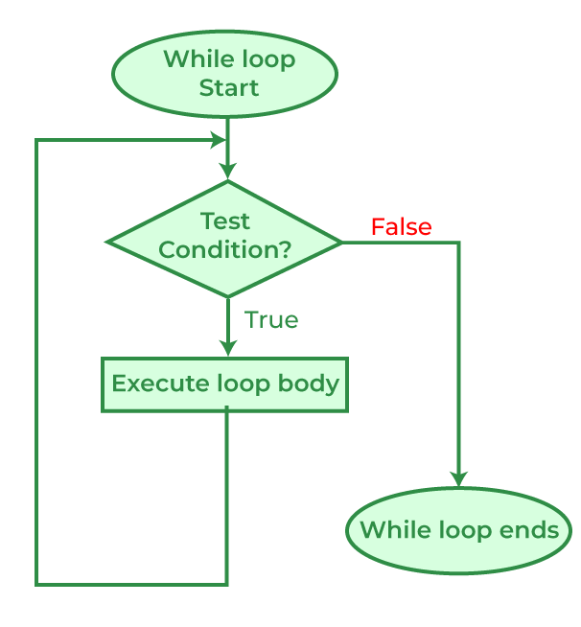
While Loops
(repetition, repetition, repetition, repetition…)
Loop Starts
Whilst there is fuel
Does your car have enough fuel example?
Car still works
While Loop Ends
Fuel has ran out…

Slide 17
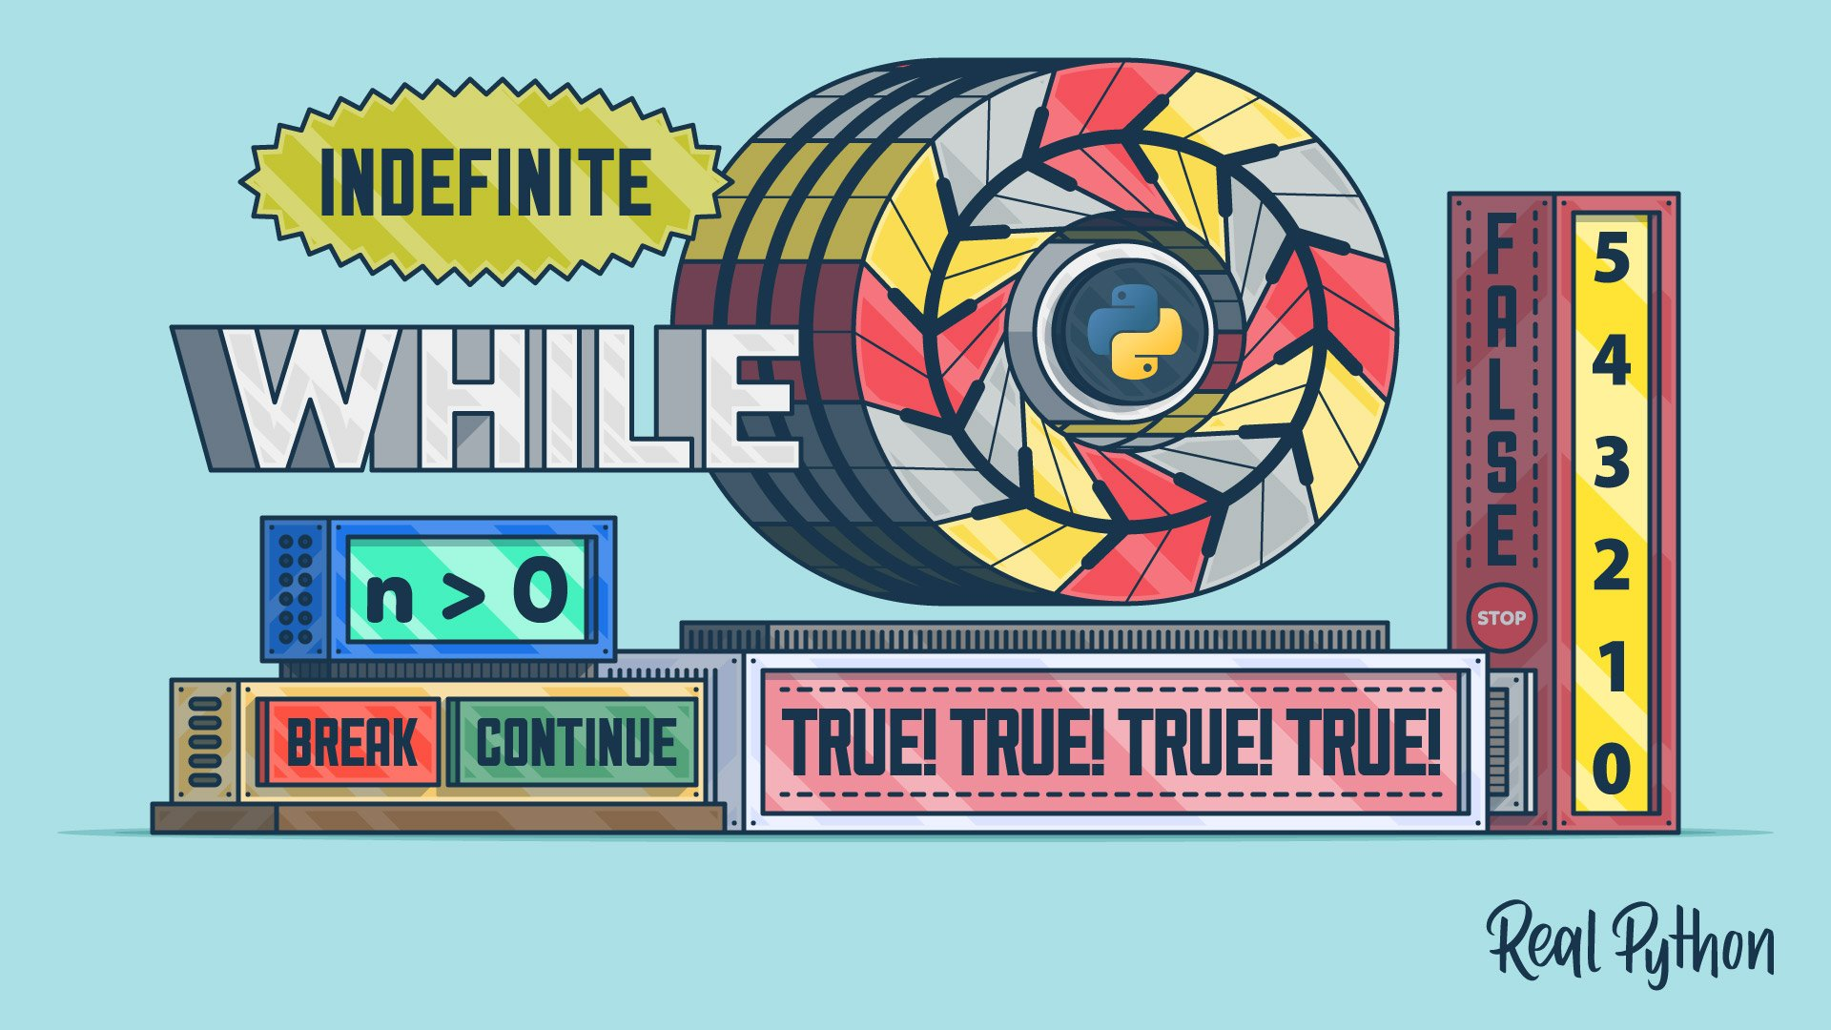
Loops
One of the most important parts of any programming language - the whole point of computers is to do the repetitive boring stuff.
Python has two loop/iteration constructs
  while, and for
Typically means repeat the code while the loop is true or false

Slide 18
While
the syntax is :
  while (<expression>):
  <statement> # can be lots!
the computer evaluates the expression, and exits the loop if it is false.
if the expression was true, the computer executes the statement(s) and then goes back to check the expression again.

Slide 19

While
as a (bad-ish) example try printing the powers of 2 until we get to 2^{N} :
        counter, value = 0, 1
        n = input("value for index?")
        n = int(n)
        print("current value is"+str(value))
        while (counter<n):
            value = 2*value; # or value *= 2;
            print("current value is"+str(value))
            counter+=1
*Doing this would save you having to type it into a calculator lots of times resulting in less stress…
Notes:
do a test of the boundary conditions on the loop

Slide 20

Loops
there are largely two kinds of loops in programming
sentinel loops, where the loop runs until a condition is encountered which you don’t know in advance - either due to external inputs or complex calculations.
counter loops, where you can be clear in advance how many iterations will occur.
Sentinel Example
‘While skittles, count the number of skittles and colour’
- The human counts the number of skittles in the bag and records their colour until the bag is empty.
Condition encountered = An empty bag of skittles…
‘While k<10, count the skittles and record their colour’
- The human counts the skittles and records the colour for the first 10 skittle.
Condition encountered = when the 10th skittle is pulled out
Counter Example
Notes:
note that the last example was probably a problem better solved by a counter loop, but sometimes you just use the one that you are most comfortable with.

Slide 21
While = sentinel
find perfect numbers
(sum of divisors add to number itself) :
    d, sum = 2, 1 # scanner and accumulator
    n = input("number to be tested")
    n = int(n)
    while (d <= (n/2)): # bit of a lazy sentinel !
        if (n%d==0): # I could have worked out
        sum += d # how high to count
      d+=1
    if (sum==n):
    print("number {} is perfect".format(n))
    else:
    print("number {} is not perfect".format(n))
Notes:
do a test of the boundary conditions on the loop

Slide 22

Getting out early !
while (and for) loops can 'abort' :
break
aborts the whole set of all possible loops, and moves on...
continue
aborts this particular loop at the 'continue' point, but goes back to see if more loops need carried out.

Slide 23
Doing other stuff !
while (and for) loops can have an else clause, although it's less often used.
The else clause gets done if the loop finishes through exhaustion, but 'naturally' - i.e. it hasn't finished through break
Oh, and the following is used more often than you'd think
while True:
name = input("Who are you?") # infinite
print("Nice to meet you, "+ name) # loop

Slide 24
Summary Example
(Find a square root by Newton-Raphson)

Slide 25
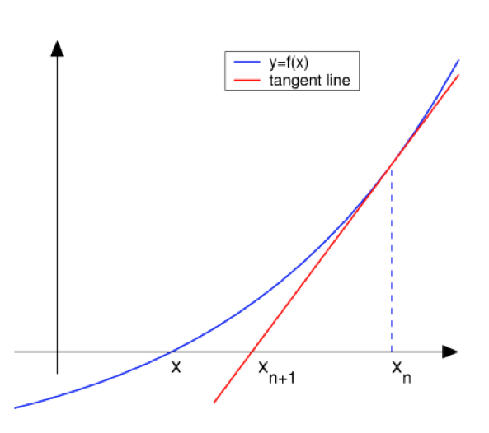

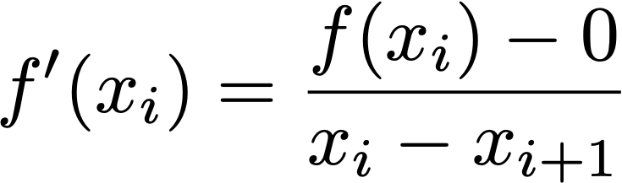
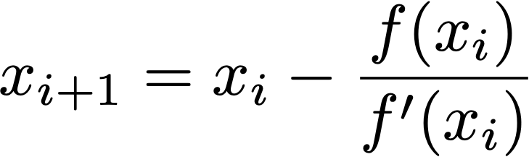



First Newton’s Method
Get closer to the goal by sliding down the tangent
Notes:
If you know it crosses the x axis at some point we can calculate that. F(x) is minus on the left side of the Y axis and +ve on the right.
You can also split the line in half each time by the bisection method to make the line shorter each time. However, always finds the root. However, Newton figured out a better method. Sliding down the tangent is a way to summarise this.

Slide 26

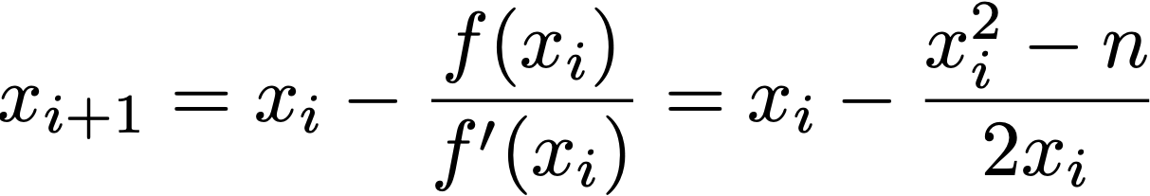
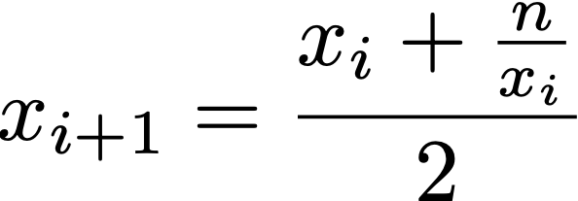
Newton’s Method
So to find the square root of ‘n’ find a formula where f(x)=0 when x=√n.
Voila :
Hence :
Notes:
bisection method gets within 4% of √100 in eight iterations, Newton gets to machine precision in seven.
Line two is the differential of f(x).
Final line with some rearranging is:

Slide 27
Square root by Newton
n = input("Root to be found for?")
n = int(n)
currentGuess = n/2 # very rough initial guess
error = 0.0001 # are we close enough?
while True: # always do the loop once
prevGuess = currentGuess
currentGuess = (prevGuess + n/prevGuess)/2
if abs(prevGuess-currentGuess)<error:
break # get out if condition met
sqRoot = currentGuess
print("Root is {:.2f}".format(sqRoot))
This is the previous end function on previous slide
Notes:
if you swap y and x then the system will give you a warning and try and do the best it can
flag what happens if the format is too small for the number.
Oh, even better, how do you divide a binary number by two
I input a number I want to figure out. Then I create it to be an integar as it came in as a string as it came from the input function.
Your guess can then be anything but lets imagine its n/2 as a first guess.
Declare an error- this is the error and when my guesses are closer to eachoether than this error then we have converged.
Loop goes like this- Forever
Previous guess is the current guess so the old guess is setup
New current guess is now going to be previous guess + …
If difference between previous guess and current guess is less than .0001 then jump out loop as ive converged enough.
Print root is.
While loops useful as you don’t know how many loops you need to do etc.

Slide 28

$√$ by Newton, 2
# some people find 'break' statements unpleasant
n = input("Root to be found for?")
n = int(n)
currentGuess = n/2 # very rough initial guess
error = 0.0001 # are we close enough?
while abs(prevGuess-currentGuess)>error: # note!
prevGuess = currentGuess
currentGuess = (prevGuess + n/prevGuess)/2
# note different logic
# note different number of iterations - happens to be ok
# usually need to do first check outside loop
sqRoot = currentGuess
print("Root is {:.2f}".format(sqRoot))
Notes:
if you swap y and x then the system will give you a warning and try and do the best it can
flag what happens if the format is too small for the number.
Oh, even better, how do you divide a binary number by two

Slide 29
For loops
Really nice fix for annoying source of errors !
But we'll need to do lists, tuples and dictionaries first.

Slide 30
for
the classic counter loop in C, Pascal, etc :
  for (i=0;i<10;i++) <statement>
i is a loop counter, which counts from zero to 9 or 10, and increments by one each time (the i++).
counting loops are ubiquitous in all programming languages - and big source of errors (is it 9 or 10?)

Slide 31
Why do we use loops for counting?
Any ideas?

Slide 32
Example 1- Level Easy
Because they can do accelerated calculations and monitor things better than a human
Take this easy example- Find the pink Dot?
FYI If you blink you will miss it
Next click of the mouse will start the animation. 3, 2, 1
1
2
3
4
5
6
7
8
9
Answer is?

Slide 33
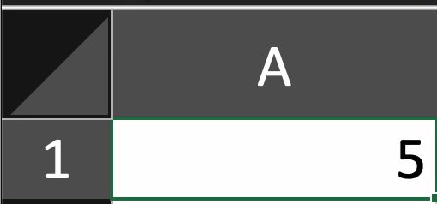
Example 2- Level Difficult
Lets say you are analysing lots of outputs from a signal generator
When the number 1 is output- An error is indicated
Human Trial. Which row of the excel sheet outputs the number 1?
Next click shows answer
Answer: Row 84
(20.51 seconds into video)
Moral of the story…
We can get python to just detect and tell us via for loops etc

Slide 34
for - taster
reminder of our powers of 2 example :
        counter, value = 0, 1
        n = input("value for index?")
        n = int(n)
        print("current value is"+str(value))
        while (counter<n):
            value = 2*value; # or value *= 2;
            print("current value is"+str(value))
            counter+=1
Notes:
do a test of the boundary conditions on the loop

Slide 35
for - taster
done with a for loop to show the improved clarity - and thus less error prone:
        value = 1
        n = input("value for index?")
        n = int(n)
        for number in range(n):
        value *= 2
        print("current value is"+str(value))
        # no counter variable to get wrong !
this is even better if the range is defined by the data set and not by a counting variable.
Notes:
do a test of the boundary conditions on the loop

Slide 36
tuples, lists, dictionaries
counting ranges defined by data 🙂

Slide 37
Tuples
you've actually seen these before:
  counter, value = 0, 1 # tuple, two elements
  dimensions3D = (16, 12, 8) # or just 16, 12, 8
  # round brackets, which are optional
  # counter, value integers, dimensions3D a tuple
  for dim in dimensions3D: # easy to use
  print(dim)
you don't need items to be the same type:
  personal_details = 'ann', 10, 'female', 2.0
remember, round brackets or no brackets.
Notes:
do a test of the boundary conditions on the loop

Slide 38
Tuples
almost everything we do below with lists we can do with tuples.
however, tuples are immutable, and so you can only change them by making a new altered copy and scrubbing the old one.
so they are great for lists that you know will never change, but are a memory and time hog for anything which will be regularly updated... for that we need lists !
Notes:
do a test of the boundary conditions on the loop

Slide 39
Lists
square brackets:
  small_numbers = [0, 1] # list, two elements
  dimensions3D = [16, 12, 8] #
  # square brackets
  for dim in dimensions3D: # use again is easy
  print(dim)
again you don't need them to be the same:
  personal_details = ['ann', 10, 'female', 2.0]
remember, square brackets.
and being mutable, means flexibility
Notes:
do a test of the boundary conditions on the loop

Slide 40
lists - useful actions
creating a list and finding its size - len():
  shopping = ['apple', 'pear', 'prune', 'date']
  print('I have', len(shopping), 'things to buy')
  # len returns an integer
accessing over a list we've seen:
  for item in shopping:
  print(item, end='')
accessing an element means you have to know where it is:
  print(shopping[0]) # will print apple
  shopping[2] = 'kiwi' # swap out prune, get kiwi
Notes:
do a test of the boundary conditions on the loop

Slide 41
lists - useful actions
adding an element to the end of a list :
  shopping = ['apple', 'pear', 'prune', 'date']
  shopping.append('mango')
  print('I have', len(shopping), 'things to buy')
  # len returns an integer = 5 now
adding an element to the middle:
  shopping.insert(0, 'lime')
  # lime is inserted into the 0th position
  # everything else shifts up one place (6 things!)
deleting an element:
del shopping[0] # the lime is chucked! (back to 5)
Notes:
do a test of the boundary conditions on the loop

Slide 42
lists - useful actions
if you don't know where an element is in the list you can still get rid of it :
  shopping = ['apple', 'pear', 'prune', 'date']
  shopping.remove('pear')
  print('I have', len(shopping), 'things to buy')
  # len returns an integer = 3 now
  # yes, if there are duplicates, it zaps the 1st one.
often you want to remove and work with an element:
  last_item = shopping.pop() # pop off the list
  first_item = shopping.pop(0) # pop off the list
Notes:
do a test of the boundary conditions on the loop

Slide 43
lists - useful actions
a few useful methods for alpha lists :
  shopping = ['apple', 'pear', 'prune', 'date']
  shopping.sort() # alphabetical sort
  shopping.reverse() # reverse the current order
  print(sorted(shopping)) # doesn't change the list,
  # gets a new temporary sorted list -> print
and for numerical lists:
  numbers = [1, 2, 3, 5, 7, 11, 13, 17]
  smallest = min(numbers)
  largest = max(numbers)
  total = sum(numbers)
Notes:
do a test of the boundary conditions on the loop

Slide 44
lists - useful actions
concatenation works as you'd expect :
  shopping = ['apple', 'pear', 'prune', 'date']
  numbers = [1, 2, 3, 5, 7, 11, 13, 17]
  numbers = numbers + [23, 27] # list concatenation
  shopping = shopping + ['lime', 'mango']
and most importantly to get a range of numbers:
  myList = list(range(6)) # 0, 1, 2, 3, 4, 5
  # range( <start=0>, stop, <step> )
  # start and step optional, default to 0, 1
  # stop value itself is excluded.
range actually a ‘generator’ producing on call.
Notes:
do a test of the boundary conditions on the loop

Slide 45
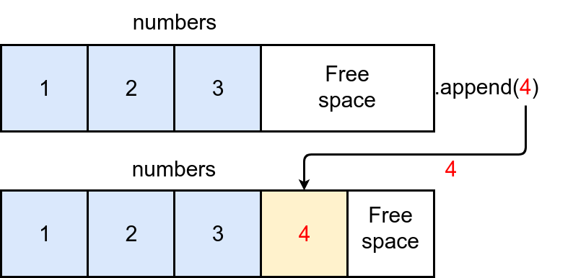
Ranges
and just to emphasise the power of ranges :
  squares = [] # empty list
  for n in range(10): # numbers 0 to 9 (exclude 10)
  square = n**2
  squares.append(square)
  # list now contains 0, 1, 4, 9, 16,... 81
  squares = list(range(1,11)) # alternately
  for n in squares:
  squares[n-1] = squares[n-1]**2
yes, negative step numbers do allow you to count downwards.
.append
Notes:
do a test of the boundary conditions on the loop

Slide 46

Copying and slicing
copy a whole list by copying every element:
  newlist = oldlist[:] # python
index and slice information below:
  # slice [<start_slice>:<end_slice>:<step>
  newlist = oldlist[:-1] # pytho
  newlist = oldlist[1:3] # yt
  newlist = oldlist[::2] # pto
  newlist = oldlist[-1:-3:-1] # no
+index |  | 0 |  | 1 |  | 2 |  | 3 |  | 4 |  | 5
-index |  | -6 |  | -5 |  | -4 |  | -3 |  | -2 |  | -1
 |  | p |  | y |  | t |  | h |  | o |  | n
+slice | 0 |  | 1 |  | 2 |  | 3 |  | 4 |  | 5 |  | 6
-slice | -6 |  | -5 |  | -4 |  | -3 |  | -2 |  | -1 |  | 0
Notes:
do a test of the boundary conditions on the loop

Slide 47
Accessing elements
once you've got slicing, indexing is ok:
  oldlist[0] # p first element
  oldlist[-1] # n last element
  # just count from beginning or end as you see fit
this works with tuples, dictionaries (just a minute) and even strings.
+index |  | 0 |  | 1 |  | 2 |  | 3 |  | 4 |  | 5
-index |  | -6 |  | -5 |  | -4 |  | -3 |  | -2 |  | -1
 |  | p |  | y |  | t |  | h |  | o |  | n
+slice | 0 |  | 1 |  | 2 |  | 3 |  | 4 |  | 5 |  | 6
-slice | -6 |  | -5 |  | -4 |  | -3 |  | -2 |  | -1 |  | 0
Notes:
do a test of the boundary conditions on the loop

Slide 48
for example: 2
already have a number of examples of running over the values in a list
myList = [11, 18, 9, 12, 23, 4, 17]
for each in myList:
if each > 15 :
print(each)
can also run over the indices of a list :
    myList = [11, 18, 9, 12, 23, 4, 17]
    for index in range(len(myList)):
        val = myList[index]
        if val>15:
            print(val)
    print("are all the values over 15")
Notes:
do a test of the boundary conditions on the loop

Slide 49
for example: 3
sum the first 20 odd numbers :
    odds = list(range(1,40,2))
    print(sum(odds)) # oops, bit too easy
    # how about without knowing that the last is 39
    sum = 0
    for num in range(1,21):
    sum += (2*num-1) # generate odd number
    print(sum)
    # or if you ‘think’ from 0 to 19
    sum = 0
    for num in range(20):
    sum += (2*num+1) # generate odd number
    print(sum)
Notes:
do a test of the boundary conditions on the loop

Slide 50
for example: 3
calculate compound interest :
principal, rate = 1000.0, .06
print("year Amount") # header of table
for year in range(10):
amount = principal * pow(1.0+rate,year)
print("{:3} {:8.2f}".format(year, amount))
all of these take up about half the space of some other programming languages I could mention.
Notes:
do a test of the boundary conditions on the loop

Slide 51
for example: 3
there are also things that lists are just wonderful for :
  shopping = ['apple', 'pear', 'prune', 'date']
  myItem = 'pear'
  if MyItem in shopping:
  print("I've already got one")
and :
  shopping = ['apple', 'pear', 'date', 'date',]
  killItem = 'date'
  while killItem in shopping:
  shopping.remove(killItem) # gets 'em all
Notes:
do a test of the boundary conditions on the loop

Slide 52


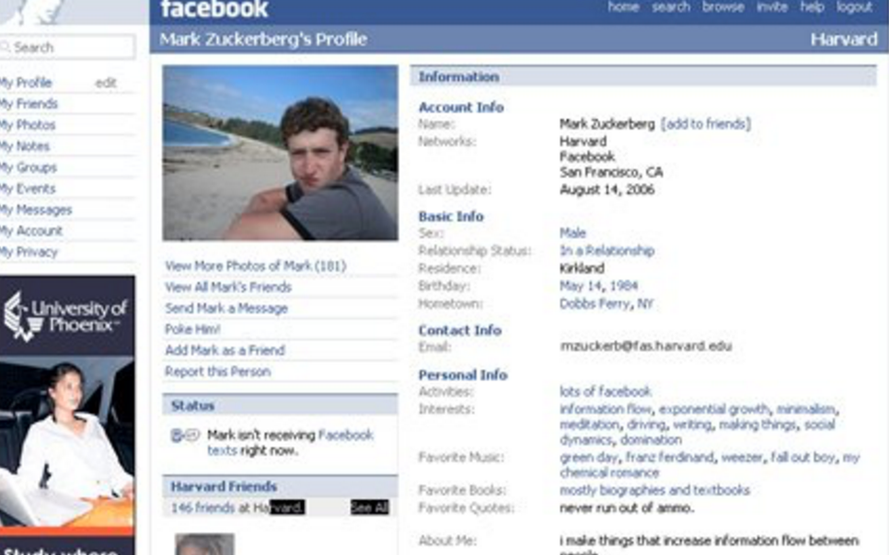

Apps that use Python
Facebook and subsidiaries like Instagram use Python for various elements of their infrastructure. Instagram is built entirely using Python and its Django framework.
Netflix uses python for sever side data analysis and back-end apps
These will figure out what your favourite programs are or what recommendations should be made to you
FYI these are old images but Python is still used today for these apps too…
Mark Zucherbergs first creation of Facemash (Social Network film) used Python to go viral…
https://github.com/thetruefuss/facemash#

Slide 53
Dictionaries

Slide 54
Dictionaries
dictionaries are lists of key : value pairs
use curly brackets (and that's all the brackets we have).
keys must be immutable and unique.
Values can be duplicates without problem.
make a dictionary
  fav_lang = {'fred' : 'python', 'anne' : 'c',
  'bob' : 'swift', 'alec' : 'perl' }
Notes:
do a test of the boundary conditions on the loop

Slide 55
Dictionaries
make a dictionary
  fav_lang = {'fred' : 'python', 'anne' : 'c',
  'bob' : 'swift', 'alec' : 'perl' }
  empty_dict = {}
access a dictionary with a key
  fav_lang = {'fred' : 'python', 'anne' : 'c',
  'bob' : 'swift', 'alec' : 'perl' }
  print(fav_lang['fred']) # python
  print(fav_lang.get('fred')) # python
  fav_lang['bob'] = 'ruby' # modifying swift->ruby
  del fav_lang['alec'] # deleting pair
Notes:
do a test of the boundary conditions on the loop

Slide 56
Dictionaries
adding to a dictionary
  fav_lang = {'fred' : 'python', 'anne' : 'c',
  'bob' : 'swift', 'alec' : 'perl' }
  fav_lang['steve'] = 'forth'
  # note that the keys and values can be numbers
  # and the keys and values can be heterogeneous
looping through dictionaries -
  for name, lang in fav_lang.items():
  print(name,lang) # both key and value
  for name in fav_lang.keys():
  print(name) # keys only
  for lang in fav_lang.values():
  print(lang) # values only
  # all these are unsorted - python doesn't order them
Notes:
do a test of the boundary conditions on the loop

Slide 57
Dictionaries
all the stuff that was useful in lists - length of dictionary, being able to pop and add items, etc) available in dictionaries
unordered, so slicing isn't useful !
  for name, lang in fav_lang.items():
  print(name,lang) # both key and value
  for name in fav_lang.keys():
  print(name) # keys only
  for lang in fav_lang.values():
  print(lang) # values only
  # all these are unsorted - python doesn't order them
Notes:
do a test of the boundary conditions on the loop

Slide 58


Dictionary Example
#Setup the dictionary- You need to say what country and its capital
country_capitals = {
"United States": "Washington D.C.",
"Italy": "Rome",
"England": "London"
}
print(country_capitals["United States"]) # Washington D.C.
print(country_capitals["England"]) # London
Answer outputs Washington D.C and London

Slide 59



Thank you
#UofGWorldChangers
@UofGlasgow

